Slide 1
Unit 2
S-6 | SLO-1 | Characteristics of MOSFET (CS , Common drain and Common gate configurations) and uses
 | SLO-2 | MOSFET Logic

Slide 2
MOSFETs
There are 2 types of MOSFET’s (metal–oxide–semiconductor field-effect transistor)
Depletion mode MOSFET (D-MOSFET)
Operates in Depletion mode the same way as a JFET when VGS ≤ 0
Operates in Enhancement mode like E-MOSFET when VGS > 0
Enhancement Mode MOSFET (E-MOSFET)
Operates only in Enhancement mode
IDSS = 0 until VGS > VT (threshold voltage)

Slide 3
Circuit Symbol MOSFET – N Channel
D
I_{D}= I_{S}
G
B (I_{B}=0, should be reverse biased)
I_{G}= 0
I_{S}
G-Gate
D-Drain
S-Source
B-Substrate or Body
S

Slide 4
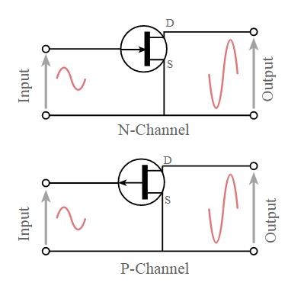
Configuration - CS
Common source: This MOSFET configuration is probably the most widely used. The common source circuit provides a medium input and output impedance levels. Both current and voltage gain can be described as medium, but the output is the inverse of the input, i.e. 180° phase change. This provides a good overall performance and as such it is often thought of as the most widely used configuration.

Slide 5
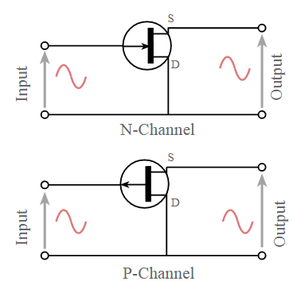
Configuration - CD
Common source: This MOSFET configuration is also known as the source follower. The reason for this is that the source voltage follows that of the gate. Offering a high input impedance and a low output impedance it is widely used as a buffer. The voltage gain is unity, although current gain is high. The input and output signals are in phase.

Slide 6
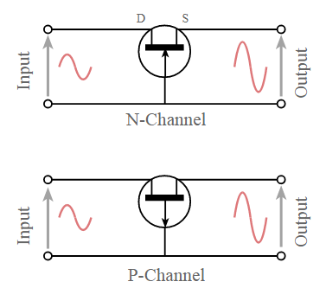
Configuration - CG
Common source: This transistor configuration provides a low input impedance while offering a high output impedance. Although the voltage is high, the current gain is low and the overall power gain is also low when compared to the other MOSFET circuit configurations available. The other salient feature of this configuration is that the input and output are in phase.

Slide 7
MOSFET (Types)
Four types:
n-channel enhancement mode
Most common since it is cheapest to manufacture
p-channel enhancement mode
n-channel depletion mode
p-channel depletion mode
n-channel
p-channel
n-channel
p-channel
Depletion type
Enhancement type

Slide 8
MOSFET characteristics
Basically low voltage device. High voltage device are available up to 600V but with limited current. Can be paralleled quite easily for higher current capability.
Internal (dynamic) resistance between drain and source during on state, R_{DS}(ON), , limits the power handling capability of MOSFET. High losses especially for high voltage device due to R_{DS}(ON) .
Dominant in high frequency application (>100kHz). Biggest application is in switched-mode power supplies.

Slide 9
The transistor consists of three regions, labeled the ``source'', the ``gate'' and the ``drain''.
The area labeled as the gate region is actually a ``sandwich'' consisting of the underlying substrate material, which is a single crystal of semiconductor material (usually silicon); a thin insulating layer (usually silicon dioxide); and an upper metal layer.
Electrical charge, or current, can flow from the source to the drain depending on the charge applied to the gate region.
The semiconductor material in the source and drain region are ``doped'' with a different type of material than in the region under the gate, so an NPN or PNP type structure exists between the source and drain region of a MOSFET.

Slide 10
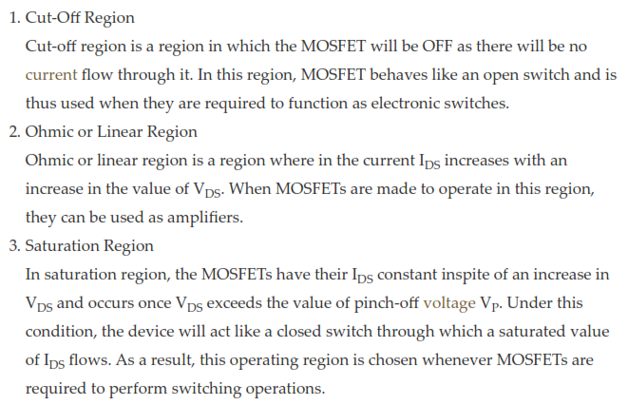

Slide 11
Difference between enhancement and depletion type MOSFET
Depletion mode MOSFET is normally turned on at zero gate voltage. Such devices are used as load resistors.
MOSFETs with enhancement modes are the common switching elements in most MOSs. These devices are deactivated at zero gate voltage and can be switched on by powering the gate.

Slide 12
Enhancement MOSFET
MOSFETs with enhancement modes can be switched on by powering the gate either higher than the source voltage for NMOS or lower than the source voltage for the PMOS.
In most circuits, this means that pulling a MOSFET gate voltage into the leakage boost mode becomes ON.
For N-type discharging devices, the threshold voltage could be about -3 V, so it could be stopped by dragging the 3 V negative gate (leakage by comparison is more positive than the NMOS source).
In PMOS, polarities are reversed.
The mode can be determined by the voltage threshold sign (gate voltage versus source voltage at the point where only a layer inversion is formed in the channel):
For a N-type FET, modulation devices have positive and depleted thresholds – modulated devices have negative thresholds;
For a P-type FET, positive mode to improve negative mode, depletion.

Slide 13
Depletion type MOSFET
Junction-effect junction transistors are the depletion mode because the gate junction would transmit the bias if the gate was taken more than a bit from the source to the drain voltage.
Such devices are used in gallium-arsenide and germanium chips, where it is difficult to make an oxide isolator.
Figure describes the construction of MOSFET type of exhaustion. Also note the MOSFET circuit type N exhaust channel symbol.
Due to its construction, it offers very high entry strength (approximately 1010 to 1015). Significant current flows for V_{DS} data at 0 volts V_{GS}.
When the gate (ie, a capacitor plate) is made positive, the channel (i.e., the other capacitor plate) will have a positive charge induced therein.
This will lead to the depletion of the major bearers (ie electrons) and therefore to the reduction in conductivity.

Slide 14
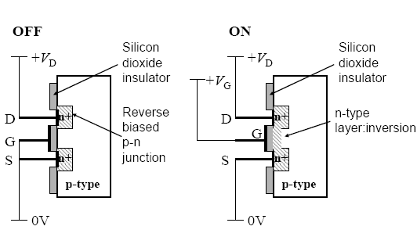
n-Channel MOSFET

Slide 15
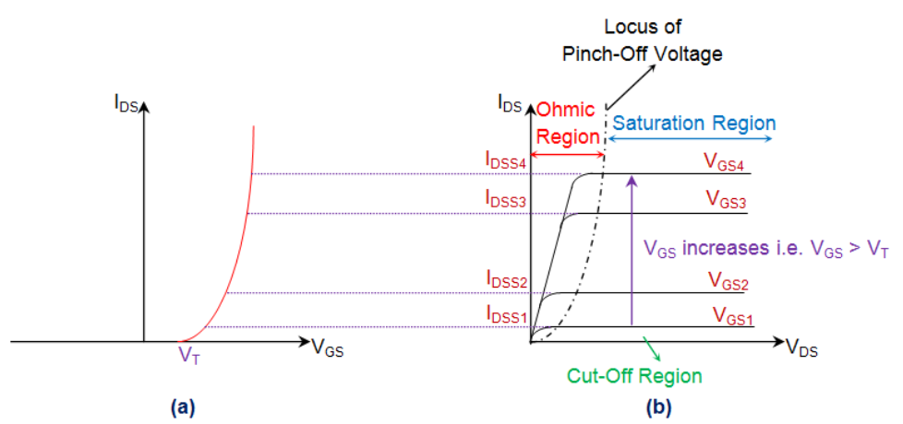

Slide 16
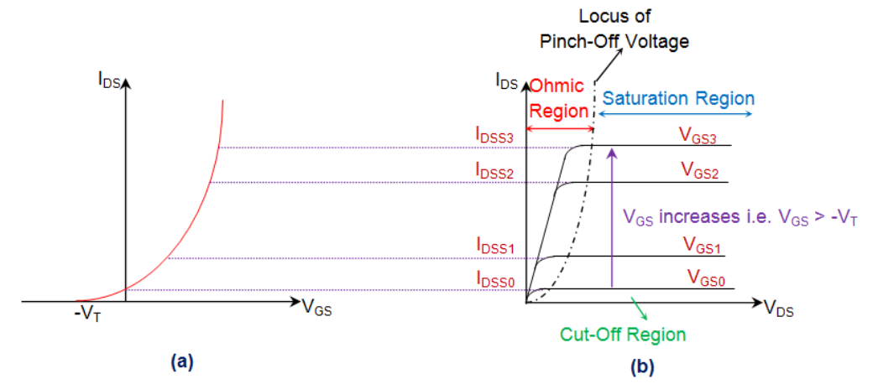

Slide 17
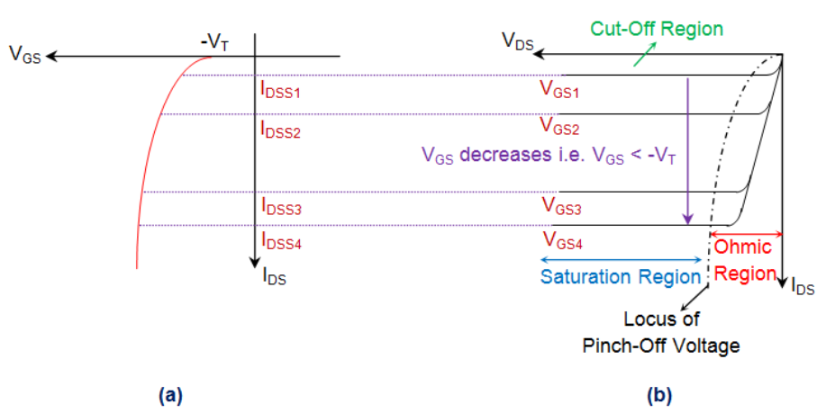

Slide 18
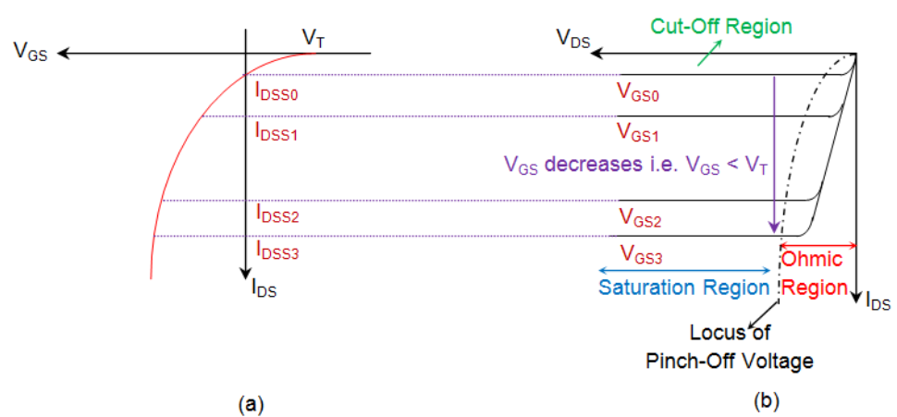

Slide 19
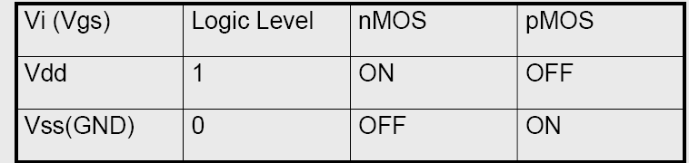
Switch models of MOSFETs

Slide 20
MOSFET - Uses
Most important device in digital design
Very good as a switch
Relatively few parasitics
Rather low power consumption
High integration density
Simple manufacturing
Economical for large complex circuits

